Slide 1
Database Service

Slide 2

Relational Introduction Service
A Database has to start somewhere Database Connection Protocol
Overview

Slide 3
Relational Database Service (RDS) Overview

Slide 4
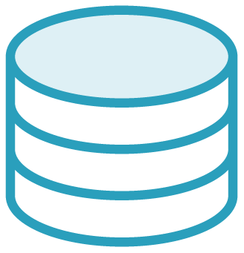
Databases
Data
Data

Slide 5

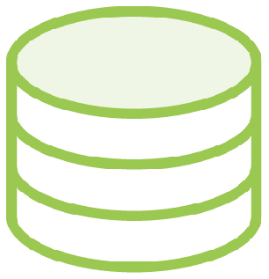

Database Admin
Software Updates
Performance Backups
Developer

Slide 6
Relational Database Service
Managed database instances in AWS running on EC2.

Slide 7
RDS Managed Task Examples
Software upgrades
Nightly database backups Monitoring

Slide 8
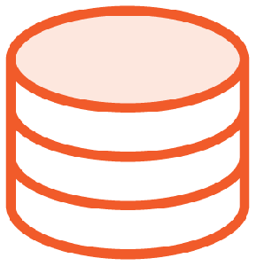
RDS Instance Architecture
EC2 Instance
r5.large
EC2 Instance Type
*can be changed after the instance has been created
Amazon Linux
PostgreSQL

Slide 9
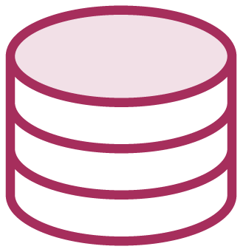

=

Slide 10
RDS Backups
Occurs daily
Conﬁgurable backup window Backups stored 1 - 35 days Restore database from backup

Slide 11
Database replication to different Availability Zone
Multi-AZ Deployment
Automatic failover in case of catastrophic event

Slide 12
Database Read Replica
Non-production copy of database
Eventual consistency with source Useful for running queries on data Will not be used as failover

Slide 13
Choosing a Database Engine in RDS

Slide 14
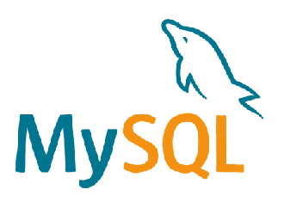



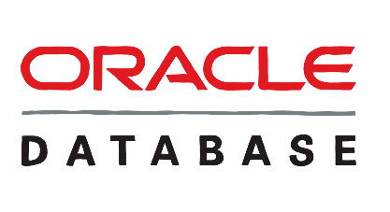

RDS Database Options

Slide 15
What database type are you using locally?

Slide 16
How much do you want to spend?

Slide 17
What database type do you have the most experience with?

Slide 18
Which database client do you like the most?

Slide 19
Creating a Database in RDS

Slide 20
Demo
Create a PostgreSQL database instance

Slide 21
Connecting to a Database in RDS

Slide 22
Demo
Connect to a PostgreSQL database with pgAdmin

Slide 23
Make sure your RDS instance security group gives access to your IP on port 5432

Slide 24
PostgreSQL Client Application
pgAdmin
Free, Cross-platform https://www.pgadmin.org/

Slide 25
Interacting with RDS in Code

Slide 26
Why Do We
Need a Database?
Persistence between application restarts
Scalability when activity increases

Slide 27
Object Relational Mapping (ORM)
Converts between database records and in-code “Objects”.

Slide 28

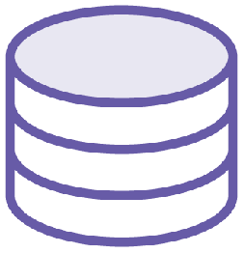
DB Connection
RDS

Slide 29
Sequelize
Node.js ORM library
Supports PostgreSQL, MySQL, and more

Slide 30
Conclusion

Slide 31
Summary
Relational database fundamentals
Pepperoni Pizzabase The key to the table

